Slide 1

Exploratory Data Analysis (EDA)
Week 1: July 5th, 2022 - July 8th, 2022
[Source Code Link Here]

Slide 2
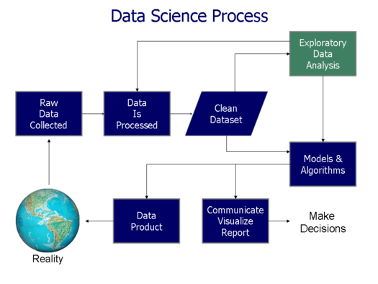
What is Exploratory Data Analysis (EDA)?
An initial analysis of the data set that summarized its main characteristic
Detects anomalies or unexpected o observations in the data
Suggest hypotheses for causal inference
Assess assumptions for models and inferences
Provide selection in appropriate statistical tools and techniques
Figure 1.1.1 AAPL price trend

Slide 3
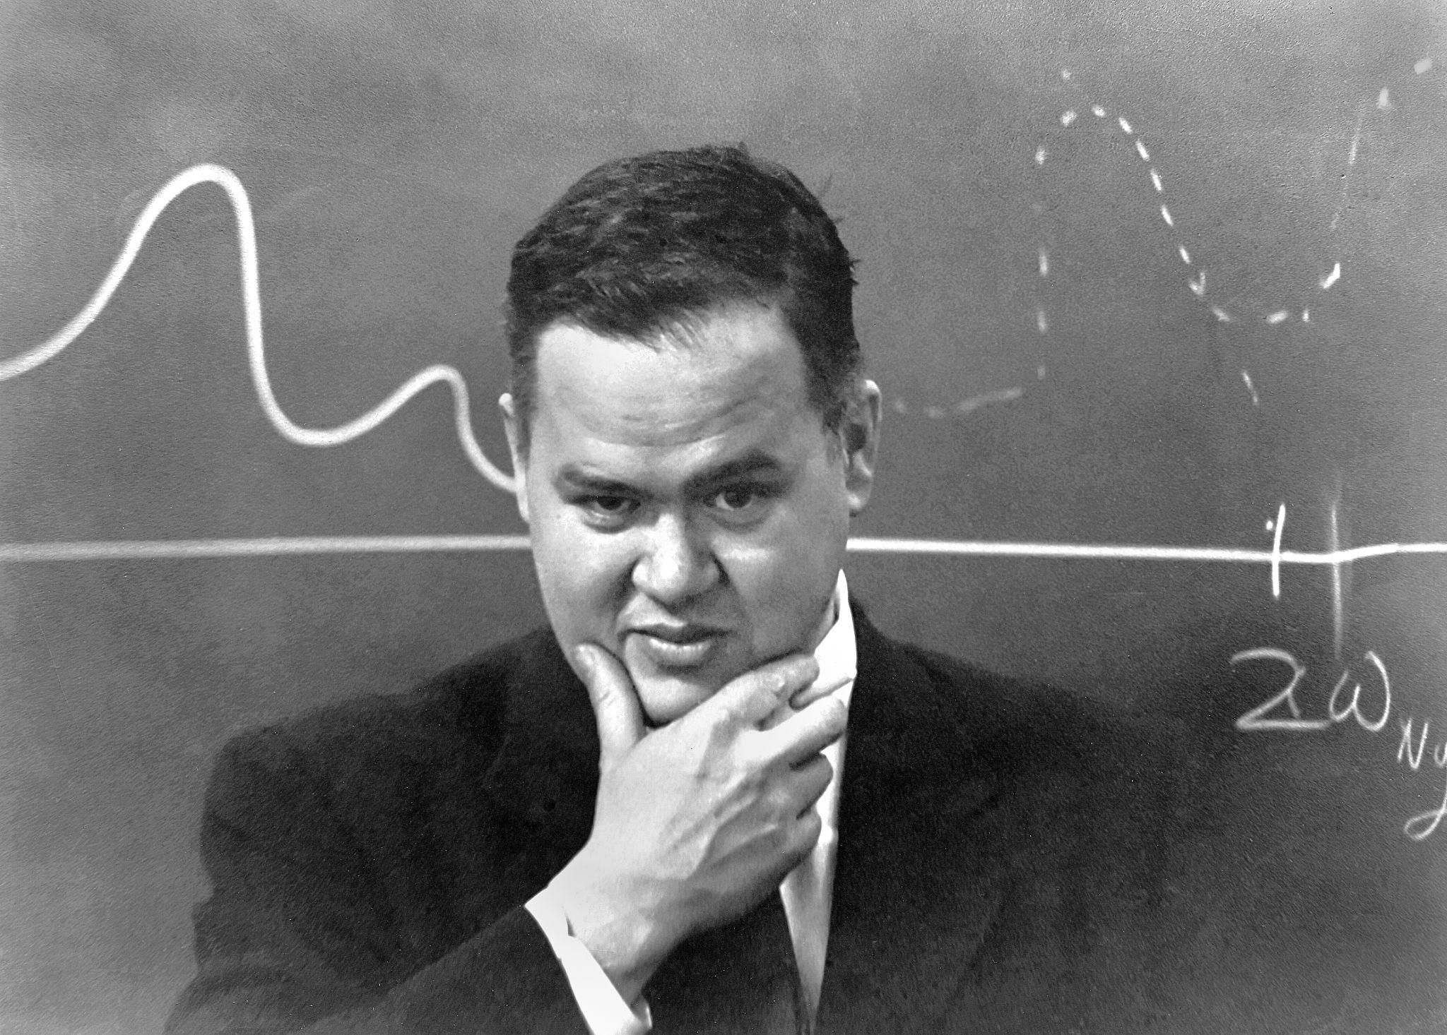
What is Exploratory Data Analysis (EDA)?
“Too much emphasis in statistics was placed on statistical hypothesis testing; more emphasis needed to be placed on using data to suggest hypotheses to test”
John W. Tukey

Slide 4


Returns
Net Return:
Gross Return:

Slide 5


Log Returns and Why?
Also called continuously compounded returns
Log returns are approximately equal to returns because if x is small, normally if |x| < 0.1, then
SInce returns are smaller over shorter periods, we can expect returns and log returns to be similar for daily returns, but less similar for yearly returns
We use log return for asset research because it has the convenient property that a k-period return is simply the sum of the single-period log returns, rather than the product as for gross returns, for instance, the log return for the most recent k periods is

Slide 6
Types of Visualizations
Time Plots
Scatter Plots
Correlation Heatmap
Box Plots
Histograms
Goal: to understand any anomaly behaviors and raw relationships of our data before cleaning them for analysis

Slide 7
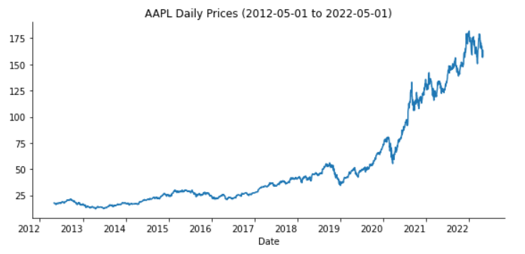
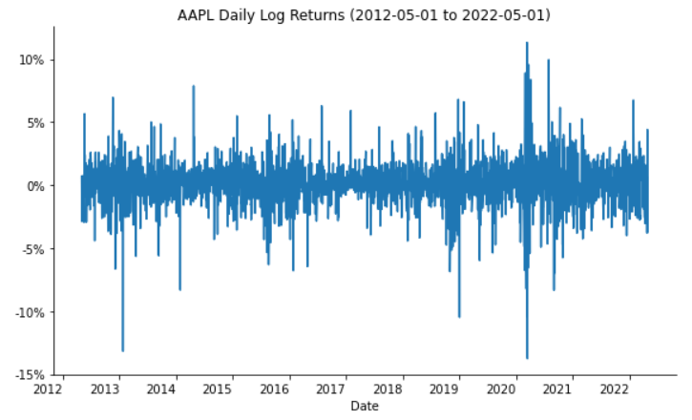
Time Plots
A time plot shows the evolution of time series, specifically asset movements, over time
Let’s say an equity analyst would like to observe the price action of Apple’s stock (Ticker: AAPL) from 5/1/2012 to 5/1/2022, a total of 2517 trading days. Not only this, he would also like to observe the evolution of returns over the same period to evaluate the asset’s volatility swings. These are accomplished via the time plots generated below:
Figure 1.2.1 AAPL price trend
Figure 1.2.2 AAPL log returns

Slide 8
Time Plots
Figure 1.2.1 AAPL price trend
Figure 1.2.2 AAPL log returns
The trend plot simply shows the impulse and corrections of AAPL’s price over time
The log return plot appears to be stationary, meaning that the nature of its random variation is constant over time, particularly around the mean
he log return plot also shows volatility clustering, because there are periods of higher, and of lower, variation within each series

Slide 9
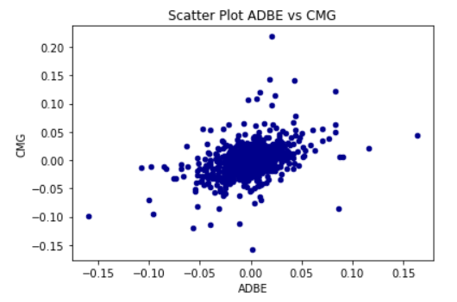
Scatter Plots
A scatter plot shows the relationship between two assets’ performances
Let’s say an analyst would like to determine whether Adobe’s (Ticker: ADBE) stock can be a good hedge for his investment in Chipotle (Ticker: CMG). He then plotted a scatter plot, with Adobe’s log return against Chipotle’s log return. The positive relationship suggests that it is relatively risky to hold both stocks at the same time.
Risky because when ADBE’s returns go down, GMG’s returns tend to go down as well, although the inverse is true as well
Figure 1.3 Scatter plot of ADBE’s log return vs CMG’s log return

Slide 10
Scatter Plots
Direction: positive association between ADBE and CMG log returns.
Linearity: a weak to moderate linear relationship is observed because the data points are slightly scattered and a linear line (in red) cannot be fitted easily through the points .
Strength: a fairly weak relationship exists because the data points does not closely surround the linear line.
Outliers: potential outliers are circled in red.
Clusters: no major clusters because all data points packed closely in one group.
Figure 1.3 Scatter plot of ADBE’s log return vs CMG’s log return

Slide 11
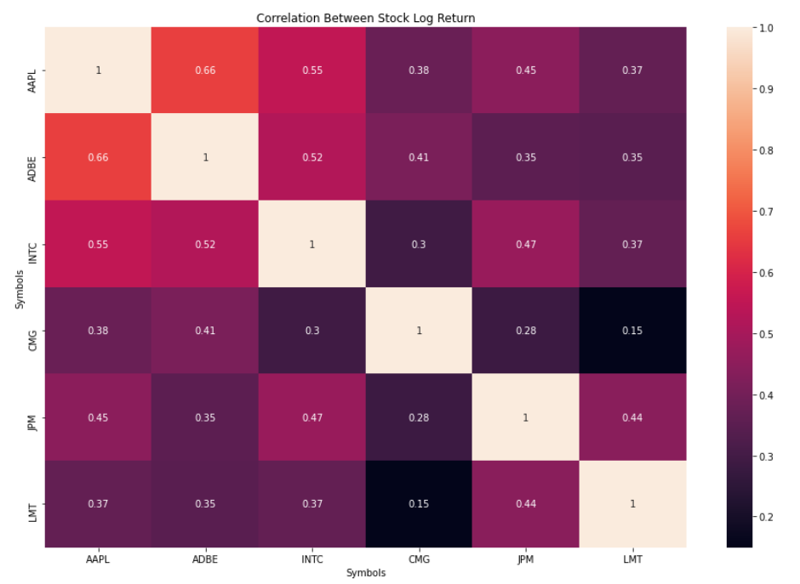
Correlation Heatmap
A correlation heatmap shows the correlation, both the direction and magnitude, of how any pair of assets correlate to each other. This is used to determine hedge potentials.
(+): positive relationship; (-): negative relationship
Interpretation:
Closer to +1 implies stronger positive correlation
Closer to -1 implies stronger negative correlation
0 implies no relationship
Figure 1.4 Correlation heatmap of AAPL, ADBE, INTC, CMG, JPM, and LMT log returns

Slide 12
Correlation Heatmap
An analyst would like to determine whether the stocks, Apple (AAPL), Adobe (ADBE), Intel (INTC), Chipotle (CMG), JP Morgan (JPM), and Lockheed Martin (LMT) can be good hedges for each other.
What would the analyst say about this portfolio (Hint: think about what the correlation values if a pair were to be a good hedge)
Figure 1.4 Correlation heatmap of AAPL, ADBE, INTC, CMG, JPM, and LMT log returns

Slide 13
Correlation Heatmap
An analyst would like to determine whether the stocks, Apple (AAPL), Adobe (ADBE), Intel (INTC), Chipotle (CMG), JP Morgan (JPM), and Lockheed Martin (LMT) can be good hedges for each other.
High positive correlation implies if one stock drops, then the other stock tends to drop as well.
High negative correlation implies if one stock drops, then the other stock tends to rise to offset some if not all of the loss.
The following pairs between AAPL, INTC, and ADBE have higher correlations above 0.5:
(AAPL, INTC), (AAPL, INTC), (INTC, ADBE)
Therefore the analyst might consider just selecting 1 of the 3 stocks to hold to avoid all 3 of them dropping at the same time.
Figure 1.4 Correlation heatmap of AAPL, ADBE, INTC, CMG, JPM, and LMT log returns

Slide 14
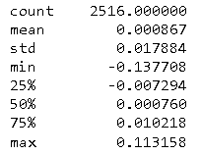
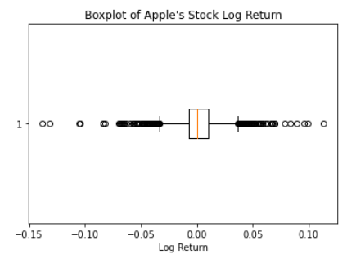
Box Plots
A box plot is useful in visualizing statistics such as the mean, range, interquartile range, and outliers of asset performances
The analyst wants to get an idea of these statistics and plotted the following box plots. According to the statistics on the side, the average log return is around 0.12% daily, Interquartile range is 1.67% and a potential outlier around -13.77%. More can be generalized from these information such as the potential outliers.
Figure 1.5.1 Descriptive statistics of AAPL’s log returns
Figure 1.5.2 Box plot of AAPL’s log returns

Slide 15
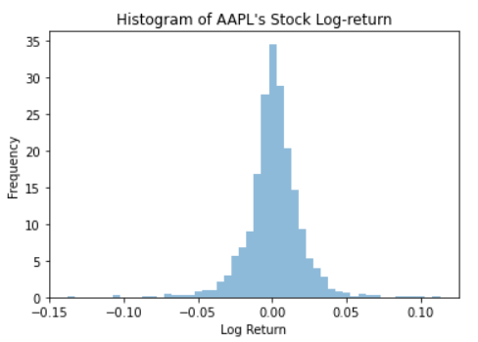
Histograms
A histogram shows the distribution of asset performance metrics along an array of values. Specifically, a performance range is divided into a series of intervals. The probability that data points falls into each interval is displayed as on the vertical axis
The analyst seeks to explore the center and spread of AAPL’s log returns. He plotted the histogram and found the mean is around 0% daily log return and the standard deviation seems to be low since there are not many points that log returns are very far from the center. (Remark: here, mean = center and standard deviation = spread)
Figure 1.6.1 Histogram of AAPL’s log returns

Slide 16
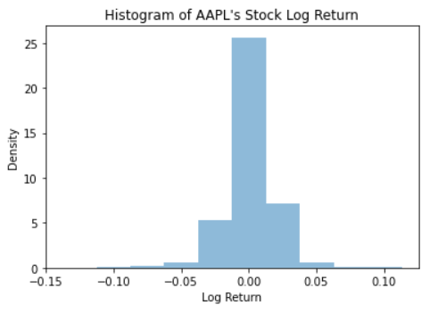



Which histogram displays the distribution of Apple’s log return the best?
a)
b)
d)
c)

Slide 17
Histogram b shows evidence of the unimodal distribution without excess bins that distract from the overall distribution or lack of bins that makes them non differentiable
a)
b)
c)
d)

Slide 18
Types of Normality Tests
Shapiro-Wilk Test
Jarque-Bera Test
Goal: to test for scenarios that deviate from what the majority result (normal distribution) expects

Slide 19
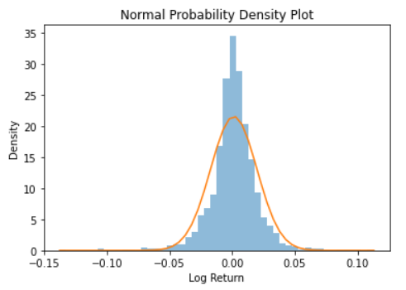
Normal Probability Density Plot
A normal probability density is a function that attempts to trace the frequencies of the histogram. This function is shown as the orange curve in the graph below.
The curve represents a view of approximately how log returns are commonly distributed
From the plot, we can see several deviations (e.g., underestimation of the peak, overestimations within +-0.05 log returns)
We will learn more about the Normal density in the Week 2 lecture
Figure 1.6.2 Histogram of AAPL’s log returns with normal density fit

Slide 20



Shapiro-Wilk Test (Test of Normality #1)
When viewing a normal density plot, it is often difficult to judge whether any deviation from linearity is systematic or instead merely due to sampling variation, so a statistical test of normality is useful
The null hypothesis ( ) is that the sample comes from a normal distribution and the alternative ( ) is that the sample comes from a non-normal distribution

Slide 21

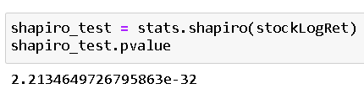
Shapiro-Wilk Test (Test of Normality #1)
The test returns a p-value of , which has 32 decimal places to the left
This p-value is smaller than the 0.05 benchmark
We then reject and conclude that AAPL’s daily log return comes from a non-normal distribution
With large sample sizes (e.g., >2000) for AAPL’s log returns, it is quite likely that normality will be rejected since any real population will deviate to some extent from normality
For financial time series, the deviation from normality in the tails is often large enough to be important
Figure 1.6.3 Histogram of AAPL’s log returns with normal density fit and Shapiro-WIlk test p-value

Slide 22



Sample Skewness & Kurtosis
Skewness and kurtosis help characterize the shape of a probability distribution
Sample Skewness:
Measures the degree of asymmetry, with symmetry implying zero skewness, positive skewness indicating a relatively long right tail compared to the left tail, and negative skewness indicating the opposite
Sample Kurtosis:
Indicates the extent to which probability is concentrated in the center and especially the tails (end values) of the distribution. The larger the number the more concentrated the tails.

Slide 23
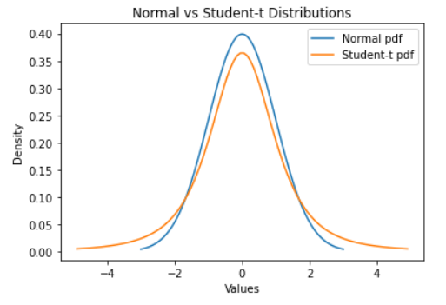
Skewness & Kurtosis - Example
Figure 1.7 Normal vs Student-t distributions
What can you say about the skewness and kurtosis of the Normal and Student-t distributions?
(If you haven’t heard about them, you can treat them as some functions for now. We will talk more about them in the Week 2 lecture)

Slide 24
Skewness & Kurtosis - Example
Figure 1.7 Normal vs Student-t distributions
The two distributions seems to be symmetric and have the same skewness of 0
The Student-t distribution seems to have heavier tails, hence higher kurtosis on the tail values compared to the Normal distribution
The Student-t distribution seems to have lower kurtosis around the +-1.75 region compared to the Normal distribution

Slide 25

Jarque Bera Test (Test of Normality #2)
A goodness-of-fit test that determines whether or not sample data have skewness and kurtosis that matches a normal distribution
Test statistic of the Jarque-Bera test is always a positive number and if it’s far from 0, it indicates that the sample data do not have a normal distribution
This test only works for a large enough number of data samples (e.g., >2000)
Jarque-Bera test statistic is defined as follows:

Slide 26

Jarque Bera Test (Test of Normality #2)
The test returns a p-value of 0
This p-value is smaller than the 0.05 benchmark
We then reject and conclude that AAPL’s daily log return comes from a non-normal distribution
We obtain the same conclusion here as from the Shapiro-WIlk test
Figure 1.6.4 Histogram of AAPL’s log returns with normal density fit and Jarque-Bera test p-value

Slide 27
Types of Data Pre-processing
Feature Importance
Label Imbalance
Multicollinearity
Goal: to clean the data so that only useful and quality information is used for analysis

Slide 28
Economic Recession Data
We will use a small and simple dataset to demonstrate the data pre-processing stage of our analysis. We use the Federal Reserve’s Economic Data (FRED) service to download the US recession dates as defined by the National Bureau of Economic Research. We also source five variables that are commonly used to predict the onset of a recession and available via FRED, namely:
JHDUSRGDPBR: U.S. recession status, 1 = recession, 0 = no recession
T10Y3M: The long-term spread of the treasury yield curve, defined as the difference between the ten-year and the three-month Treasury yield (%)
UMCSENT: The University of Michigan’s consumer sentiment indicator (Index unit)
NFCI: The National Financial Conditions Index (Index unit)
NFCINONFINLEVERAGE: The NFCI nonfinancial leverage subindex (Index unit)
GDPC1: Real GDP with inflation-adjusted value of the goods and services produced by labor and property located in the U.S. (Billions of U.S. dollars)
We gather these data dating between 1980 and 2022, a total of 481 months of data.

Slide 29
Economic Recession Data - Data Types of Variables
 | Use Case | Example
Numerical Variables
Discrete | Counts of individuals and values Non-decimals, or finite values | Number of days that you hold a stock position
Continuous | Non-finite values Allows decimals | Percentage change in daily asset prices
Categorical Variables
Binary | Yes/No outcomes | Up or down direction of stock
Nominal | Groups/categories with no rank or order between them | Index tickers (e.g., SPX, NDX, RUT)
Ordinal | Groups/categories that are ranked in a specific order | A-> B→ C, and so on

Slide 30
Economic Recession Data - Response vs Explanatory Variable
Response (Dependent) variable:
An outcome we are trying to predict
Seen as the result of the experiment that depends on the explanatory variable
Explanatory (Independent) variable:
Also known as predictors, features, or covariates. These are variables that are used to predict the outcomes via use-defined models
Seen as the factor which the response variable depends on

Slide 31
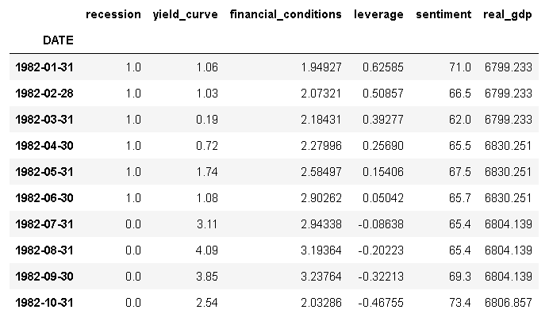
Economic Recession Data - Response vs Explanatory Variable
Figure 1.8.1 FRED data before scaling
Considering the research problem, what is the response variable? What are the explanatory variables?

Slide 32
Economic Recession Data - Response vs Explanatory Variable
Figure 1.8.1 FRED data before scaling
response variable
explanatory variables

Slide 33
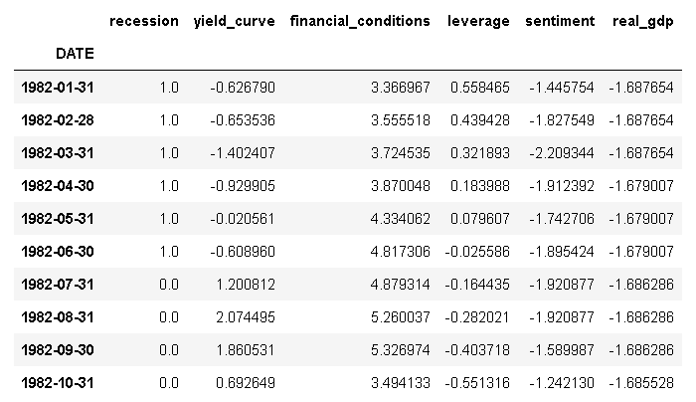
Economic Recession Data - Standard Scaling
Notice that the indicators have different units (e.g.,yield curve is in %, real GDP is in billions of dollars), so we have to scale them for them to be on the same unit scale
We scale the features so all indicators have mean of 0 and standard deviation of 1; this process is also called standardization or normalization
There are other methods of scaling, for example Min Max Scaling, Unit Vector Scaling, and more, but we will focus on Standard Scaling for this course
Standard Scaling
Figure 1.8.1 FRED data before scaling
Figure 1.8.2 FRED data after scaling

Slide 34
Training and Testing Data
Training set:
The set of example points observed by the model to learn their patterns and relationships
Normally using 70-80% of all observations
Testing set:
The set of example points used to provide an unbiased evaluation or supervision of the final model on the training data
If the data in the test data set has never been used in training, the test data set is also called a holdout data set
Normally using 20-30% of all observations
—----------------------------------------------------------------------------
We use the following code to split the data for us
In practice, the explanatory_data and response_data are replaced with your feature and outcome data, respectively.

Slide 35

Feature Importance
A score assigned to the input features based on how useful they are in predicting the target (response) variable
A number close to 0 indicates the variable is not important and could be dropped
The larger the score the more influence the feature has on our prediction

Slide 36
Feature Importance - Computation Flowchart
oob sample 1
Tree 1
classification error 1
Training Sample
oob sample 2
Tree 2
classification error 2
importance score
.
.
.
.
.
.
.
.
.
.
.
.
oob sample 2
Tree 3
classification error 3

Slide 37
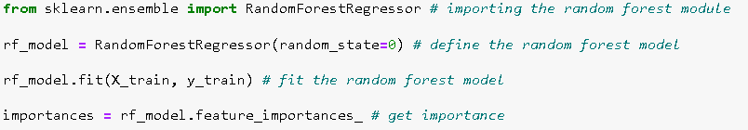
Feature Importance - Code
These are done in 4 lines of code in Python…

Slide 38
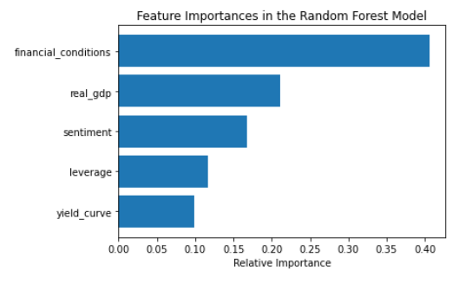
Feature Importance - Economic Recession Data
We would use the Random Forest Regressor to fit a number of classifying decision trees on various oob samples of the dataset and use averaging to calculate the classification error and evaluate predictive power of the decision trees
We ranked the features by their importance scores on the right
financial_conditions has the highest score, hence being the most important in predicting recession
yield_curve has the lowest score, hence being the least important in predicting recession
If you find the data set too complex (e.g., >100 features), you may choose to drop the features that have the lowest importance scores
Figure 1.9 Feature importances using Random Forest Model

Slide 39
Label Imbalance
A classification problem where the distribution of examples across the classes is not equal, or in other words skewed
For example, we may collect measurements of cats and have 80 samples of one cat species and 20 samples of a second cat species. This represents an example of an imbalanced classification problem. A 50-50 or a near-50-50 sample species would form a well-balanced classification problem.
Imbalance labels can result in biased predictions toward the majority class
Sometimes it is critical when classifying the minority class as belonging to the majority class, a so-called false negative (e.g., cancer prediction)

Slide 40
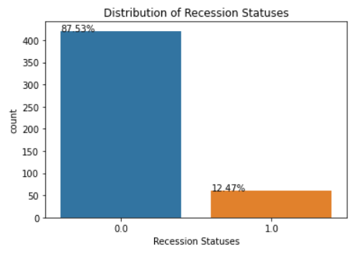
Label Imbalance - Economic Recession Data
The recession labels seems to be highly imbalanced with the economy not in recession 87.51% of the time and in recession 12.47% of the time
Our model will be biased towards predictions of non-recession days
😿 If we misclassify recession times as non-recession, this could have detrimental effects on the economy
Traders haven’t guarded up against price plummets
Feds don’t have enough time to respond with monetary and fiscal policies
What can we do about this?
Figure 1.10.1 Recession status distribution

Slide 41
Label Imbalance - Solutions
Gather more data
Delete instances from the majority class and add companies from the minority class
Synthetic Minority Over-sampling Technique (SMOTE)
Try a different classification algorithms (e.g., decision trees works well with imbalance data)
Penalized versions of classification algorithms (e.g., pay more attention to the minority class)
More tactics here

Slide 42
Label Imbalance - SMOTE + Undersampling Improvement
Synthetic Minority Over-sampling Technique (SMOTE)
Upsample the minority class (recession=1) by finding its k (default: k=5) nearest minority class neighbors to upsample the minority class
Tweak the minority class to have 15 % the number of examples of the majority class
Undersampling:
Downsample the majority class (recession=0) by randomly removing samples from the class
Tweak the majority class to have 50 % more than the minority class

Slide 43
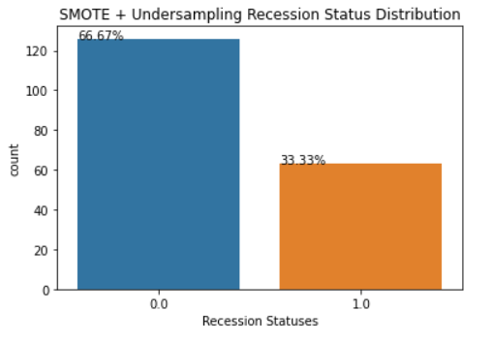
Label Imbalance - SMOTE + Undersampling Improvement
After applying SMOTE + Undersampling, the recession labels seems to be less imbalanced with 66.67% non-recession labels and 33.33% recession labels
This corresponds to about 126 examples in the majority class and about 63 examples in the minority class
Minority-to-majority ratio improved from 1:7 to 1:2 😻
Figure 1.10.2 SMOTE recession status distribution

Slide 44

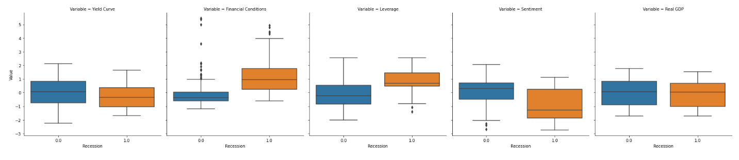
Feature Value Distribution (by recession status)
We can also display box plots to show the how each feature values are distributed by when there is a recession vs when there is no recession
Figure 1.11 Feature distributions by recession status

Slide 45
Multicollinearity
A regression problem (e.g., logistic regression, multiple linear regression)
Occurs when one independent variable (feature) in a regression model is linearly correlated with another independent variable
Makes it difficult to distinguish between individual effects between the correlated features
Model results become very sensitive to tiny changes in correlated features, which will throw off the accuracy of our analysis

Slide 46
Multicollinearity - Solutions
Drop the variables that are highly correlated (> 0.5 correlation)
Increase the sample space to include new observations
Create a new feature by performing operations on correlated features (e.g., adding them together)
Perform dimension reduction techniques such as Principal Component Analysis (PCA) to eliminate correlated features
Apply feature penalties to regression models (e.g., LASSO and Ridge regressions)

Slide 47
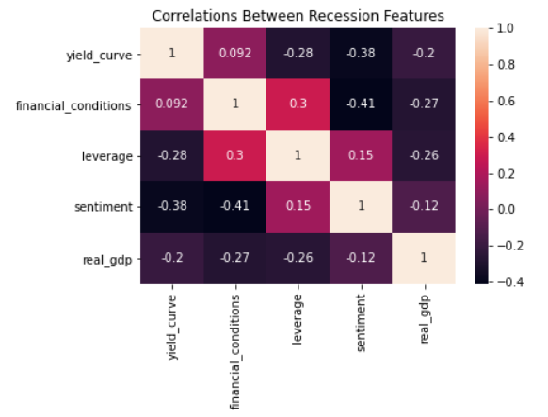
Multicollinearity - Economic Recession Data
What can you say about the multicollinearity of the features?
Figure 1.12 Correlation heatmap of recession features

Slide 48
Multicollinearity - Economic Recession Data
We can see a moderate correlation between the variables, especially since none of the correlations are > 0.5, we do not have to worry about multicollinearity problem in this data set.
Figure 1.12 Correlation heatmap of recession features

Slide 49
Multicollinearity - Economic Recession Data
What if there is a large number of covariates (e.g., > 50) in our data such that the correlation heatmap is too complicated to look at ?

Slide 50

Multicollinearity - Variance Inflation Factor (VIF)
A measure of the amount of multicollinearity in a set of multiple regression variables.
A high VIF indicates that the associated independent variable is highly collinear with the other variables in the model
A VIF of 1 indicates the variables are not correlated, a VIF between 1 and 5 indicates moderate correlation, and a VIF above 5 indicates high correlation.

Slide 51
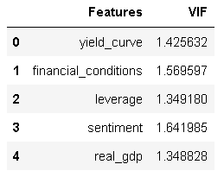
Multicollinearity - Variance Inflation Factor (VIF)
We observe moderate correlations between the features because their VIF values are between 1 and 5
We do not have to drop any particular features for our analysis.
Figure 1.13 VIF by features

Slide 52
Other EDA Techniques
Chi-square test for Independence (between categorical variables)
Summary Statistics Table (mean, standard deviation, skewness, kurtosis)
Quantile-Quantile (QQ) Plots
Principal Component Analysis (PCA)
Exploratory Factor Analysis (EFA)

Slide 53
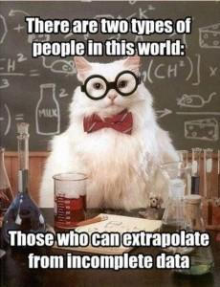
Summary
Preliminary Visualization
Time Plots
Scatter Plots
Correlation Heatmap
Box Plots
Histograms
Preliminary Normality Testing
Shapiro-Wilk Test
Jarque-Bera Test
Pre-processing
Feature Importance
Label Imbalance
Multicollinearity

Slide 54
Week 1 Assignments
[Week 1 Lab Link Here]
This week’s lab is due by 10th July, 2022 (11:59 pm CDT )
1st team meeting by 11th July, 2022 (11:59 pm CDT )
You are encouraged to discuss the lab with each other, but ultimately all questions must be solved and written up independently.
Any questions can be directed through email or through office hours.
Email Info
John Lee: lykjohn@umich.edu
Johnson Zhang: shunqi@uchicago.edu
Eric Lee: ericsclee@uchicago.edu
Office Hours Info:
Please email the course instructor/assistant to set an appointment.

